Slide 1
Understanding Requirements
Pressman R S, Bruce R.Maxim, “Software engineering - A Practitioner’s Approach”, Eighth Edition, Tata McGraw-Hill, 2014
Chapter 8: 8.1-8.9

Slide 2
Topics Covered
Topic | Text Book Reference
Requirements Engineering | 8.1
Establishing the Group Work | 8.2
Eliciting Requirements | 8.3
Developing Use cases | 8.4
Building the Analysis Model | 8.5

Slide 3
Requirements Engineering
Building software is so compelling that many software developers want to jump right in before they have a clear understanding of what is needed
They argue that things will become clear as they build, that project stakeholders will be able to understand need only after examining early iterations of the software, that things change so rapidly that any attempt to understand requirements in detail is a waste of time, that the bottom line is producing a working program, and that all else is secondary
But each argument is flawed and can lead to a failed software project

Slide 4
Requirements Engineering
The broad spectrum of tasks and techniques that lead to an understanding of requirements is called requirements engineering
From a software process perspective, requirements engineering is a major software engineering action that begins during the communication activity and continues into the modeling activity
It must be adapted to the needs of the process, the project, the product, and the people doing the work

Slide 5
Requirements Engineering
Requirements engineering builds a bridge to design and construction
Requirements engineering encompasses seven distinct tasks
Inception
Elicitation
Elaboration
Negotiation
Specification
validation and
Management
It is important to note that some of these tasks occur in parallel and all are adapted to the needs of the project

Slide 6
Inception
How does a software project get started? Is there a single event that becomes the catalyst for a new computer-based system or product, or does the need evolve over time? There are no definitive answers to these questions
At project inception, you establish a basic understanding of the problem, the people who want a solution, the nature of the solution that is desired, and the effectiveness of preliminary communication and collaboration between the other stakeholders and the software team

Slide 7
Elicitation
An important part of elicitation is to establish business goals
Your job is to engage stakeholders and to encourage them to share their goals honestly
Once the goals have been captured, a prioritization mechanism should be established, and a design rationale for a potential architecture (that meets stakeholder goals) can be created

Slide 8
Elicitation
A number of problems that are encountered as elicitation occurs:
Problems of scope occur when the boundary of the system is ill-defined or the customers and users specify unnecessary technical detail that may confuse, rather than clarify, overall system objectives
Problems of understanding are encountered when customers and users are not completely sure of what is needed, have a poor understanding of the capabilities and limitations of their computing environment, don’t have a full understanding of the problem domain, have trouble communicating needs, omit information that is believed to be “obvious,” specify requirements that conflict with the needs of other customers and users, or specify requirements that are ambiguous or untestable
Problems of volatility occur when the requirements change over time. To help overcome these problems, you must approach the requirements-gathering activity in an organized manner

Slide 9
Elaboration
The information obtained from the customer during inception and elicitation is expanded and refined during elaboration
Elaboration is driven by the creation and refinement of user scenarios that describe how the end user (and other actors) will interact with the system
Each user scenario is parsed to extract analysis classes—business domain entities that are visible to the end user
The attributes of each analysis class are defined, and the services 4 that are required by each class are identified
The relationships and collaboration between classes are identified, and a variety of supplementary diagrams are produced

Slide 10
Negotiation
It isn’t unusual for customers and users to ask for more than can be achieved, given limited business resources
It’s also relatively common for different customers or users to propose conflicting requirements, arguing that their version is “essential for our special needs.”
You have to reconcile these conflicts through a process of negotiation
Customers, users, and other stakeholders are asked to rank requirements and then discuss conflicts in priority
Using an iterative approach that prioritizes requirements, assesses their cost and risk, and addresses internal conflicts, requirements are eliminated, combined, and/or modified so that each party achieves some measure of satisfaction

Slide 11
Specification
In the context of computer-based systems (and software), the term specification means different things to different people
A specification can be a written document, a set of graphical models, a formal mathematical model, a collection of usage scenarios, a prototype, or any combination of these
It is sometimes necessary to remain flexible when a specification is to be developed

Slide 12
Validation
The work products produced as a consequence of requirements engineering are assessed for quality during a validation step
Requirements validation examines the specification to ensure that all software requirements have been stated unambiguously; that inconsistencies, omissions, and errors have been detected and corrected; and that the work products conform to the standards established for the process, the project, and the product
The primary requirements validation mechanism is the technical review

Slide 13
Management
Requirements for computer-based systems change, and the desire to change requirements persists throughout the life of the system
Requirements management is a set of activities that help the project team identify, control, and track requirements and changes to requirements at any time as the project proceeds

Slide 14
Discussion
Why is it that many software developers don’t pay enough attention to requirements engineering? Are there ever circumstances where you can skip it?

Slide 15
Establishing the group work
8.2

Slide 16
Establishing the Group work
Identify stakeholders
Stakeholder can be “anyone who benefits in a direct or indirect way from the system which is being developed”
Ex. Business manager, project manager, marketing people, software engineer, support engineer, end-users, internal-external customers, consultants, maintenance engineer.
Each one of them has different view of the system.
Recognize multiple points of view
Marketing group concern about feature and function to excite potential market. To sell easily in the market.
Business manager concern about feature built within budget and will be ready to meet market.
End user – Easy to learn and use.
SE – product functioning at various infrastructure support.
Support engineer – Maintainability of software.
Role of RE is to categorize all stakeholder information in a way that there could be no inconsistent or conflict requirement with one another

Slide 17
Establishing the Group work
Work toward collaboration
RE identify areas of commonality (i.e. Agreed requirement) and areas of conflict or inconsistency.
It does not mean requirement defined by committee. It may happen that they provide just view of their requirement.
Business manager or senior technologist may make final decision.
Asking the first questions
Who is behind the request for this work?
Who will use the solution?
What will be the economic benefit of a successful solution
Is there another source for the solution that you need?
These questions will help – stakeholder interest in the software & measurable benefit of successful implementation

Slide 18
Asking the question
Next set of questions – better understanding of the problem.
What business problem (s) will this solution address?
Describe business environment in which the solution will be used?
Will performance or productivity issues affect the solution is approached?
Final set of questions – Effectiveness of communication
Are my questions relevant to the problem?
Am I asking too many questions?
Can anyone else provide additional information?
Should I be asking you anything else?

Slide 19
Eliciting Requirement
8.3

Slide 20
Eliciting Requirement
Approach for eliciting requirement:
Collaborative Requirements Gathering
Quality Function Deployment
User Scenarios
Elicitation Work Products

Slide 21
Collaborative Requirement Gathering
Meetings are attended by all interested stakeholders.
Rules established for preparation and participation.
Agenda should be formal enough to cover all important points, but informal enough to encourage the free flow of ideas.
A facilitator controls the meeting.
A definition mechanism (blackboard, flip charts, etc.) is used.
During the meeting:
The problem is identified.
Elements of the solution are proposed.
Different approaches are negotiated.
A preliminary set of solution requirements are obtained.
The atmosphere is collaborative and non-threatening.
Flow of event – Outline the sequence of events occurs
Requirement gathering meeting ( initial meeting)
During meeting
Follow the meeting.

Slide 22
Collaborative requirement gathering (contd.)
In initial meeting, distribute “Product request” (defined by stakeholder) to all attendee.
Based on product request, each attendee is asked to make
List of objects (Internal or external system objects)
List of services( Processes or functions)
List of constraints ( cost, size, business rules) and performance criteria( speed, accuracy) are developed.
Collect lists from everyone and combine
Combined list eliminates redundant entries, add new ideas , but does not delete anything
Objective is to develop a consensus list in each topic area (objects, services, constraints and performance)
Based on lists, team is divided into smaller sub-teams : each works to develop mini-specification for one or more entries on each of the lists

Slide 23
Collaborative requirement gathering (Contd.)
Each sub-team presents its mini-specification to all attendees for discussion. Addition, deletion and further elaboration are made
Now each team makes a list of validation criteria for the product and present to team
Finally, one or more participants is assigned the task of writing a complete draft specification

Slide 24
Example: SafeHome Write up on home security function that is to be part of SafeHome
Our research indicates that the market for home management systems is growing at a rate of 40 percent per year. The first SafeHome function we bring to market should be the home security function. Most people are familiar with “alarm systems” so this would be an easy sell.
The home security function would protect against and/or recognize a variety of undesirable “situations” such as illegal entry, fire, flooding, carbon monoxide levels, and others. It’ll use our wireless sensors to detect each situation, can be programmed by the homeowner, and will automatically telephone a monitoring agency when a situation is detected.

Slide 25
Discussion
Identify list of
Services
Objects
Constraints and performance criteria
In SafeHome Application based on above narration

Slide 26
Example: SafeHome Identify Objects
Objects
control panel,
Services
configuring the system,
Constraints
the system must recognize when sensors are not operating,
window and door sensors,
Performance criteria
a sensor event should be recognized within one second, and an event priority scheme should be implemented
smoke detectors,
motion detectors,
an event (a sensor has been activated), a display
an alarm,
a PC
telephone numbers,
a telephone call
setting the alarm, monitoring the sensors,
dialing the phone,
programming the control panel, and
reading the display (note that services act on objects)
must be user friendly,
must interface directly to a standard phone line

Slide 27
Quality Function Deployment
It is a technique that translate the needs of the customer into technical requirement for software.
Concentrates on maximizing customer satisfaction.
QFD emphasizes – what is valuable to the customer and then deploys these values throughout the engineering process.
Three types of requirement:
Normal Requirements – reflect objectives and goals stated for product. If requirement are present in final products, customer is satisfied.
Expected Requirements – customer does not explicitly state them. Customer assumes it is implicitly available with the system.
Exciting Requirements- Features that go beyond the customer’s expectation.
During meeting with customer –
Function deployment determines the “value” of each function required of the system.
Information deployment identifies data objects and events and also tied with functions.
Task deployment examines the behavior of the system.
Value analysis determines the priority of requirements during these 3 deployments.

Slide 28
User Scenario
It is difficult to move into more software engineering activities until s/w team understands how these functions and features will be used by diff. end-users.
Developers and users create a set of usage threads for the system to be constructed
A use-case scenario is a story about how someone or something external to the software (known as an actor) interacts with the system.
Describe how the system will be used
Each scenario is described from the point-of-view of an “actor”—a person or device that interacts with the software in some way

Slide 29
Elicitation Work Products
Elicitation work product will vary depending upon the size of the system or product to be built.
Statement of need and feasibility.
Statement of scope.
List of participants in requirements elicitation.
Description of the system’s technical environment.
List of requirements and associated domain constraints.
List of usage scenarios.
Any prototypes developed to refine requirements.

Slide 30
Agile Requirements Elicitation
Within the context of an agile process, requirements are elicited by asking all stakeholders to create user stories
Each user story describes a simple system requirement written from the user’s perspective
User stories can be written on small note cards, making it easy for developers to select and manage a subset of requirements to implement for the next product increment
Proponents claim that using note cards written in the user’s own language allows developers to shift their focus to communication with stakeholders on the selected requirements rather than their own agenda
Although the agile approach to requirements elicitation is attractive for many software teams, critics argue that a consideration of overall business goals and nonfunctional requirements is often lacking
In some cases, rework is required to accommodate performance and security issues
In addition, user stories may not provide a sufficient basis for system evolution over time

Slide 31
Discussion
You have been given the responsibility to elicit requirements from a customer who tells you he is too busy to meet with you. What should you do?

Slide 32
Discussion
Discuss some of the problems that occur when requirements must be elicited from three or four different customers.

Slide 33
Developing use cases
8.4

Slide 34
Developing Usecases
The first step in writing a use case is to define the set of “actors” that will be involved in the story
Actors are the different people (or devices) that use the system or product within the context of the function and behavior that is to be described
Actors represent the roles that people (or devices) play as the system operates
Defined somewhat more formally, an actor is anything that communicates with the system or product and that is external to the system itself
Every actor has one or more goals when using the system

Slide 35
Developing Usecases
Because requirements elicitation is an evolutionary activity, not all actors are identified during the first iteration
It is possible to identify primary actors during the first iteration and secondary actors as more is learned about the system
Primary actors interact to achieve required system function and derive the intended benefit from the system
They work directly and frequently with the software
Secondary actors support the system so that primary actors can do their work

Slide 36
Developing Usecases
Once actors have been identified, use cases can be developed
A number of questions that should be answered by a use case:
Who is the primary actor, the secondary actor(s)?
What are the actor’s goals?
What preconditions should exist before the story begins?
What main tasks or functions are performed by the actor?
What exceptions might be considered as the story is described?
What variations in the actor’s interaction are possible?
What system information will the actor acquire, produce, or change?
Will the actor have to inform the system about changes in the external environment?
What information does the actor desire from the system?
Does the actor wish to be informed about unexpected changes?

Slide 37
Discussion
Identify four actors for SafeHome example

Slide 38
SafeHome
Homeowner (a user),
setup manager (likely the same person as homeowner, but playing a different role),
sensors (devices attached to the system), and
the monitoring and response subsystem (the central station that monitors the SafeHome home security function)

Slide 39
SafeHome
The homeowner actor interacts with the home security function in a number of different ways using either the alarm control panel or a PC
The homeowner (1) enters a password to allow all other interactions, (2) inquires about the status of a security zone, (3) inquires about the status of a sensor, (4) presses the panic button in an emergency, and (5) activates/deactivates the security system.

Slide 40
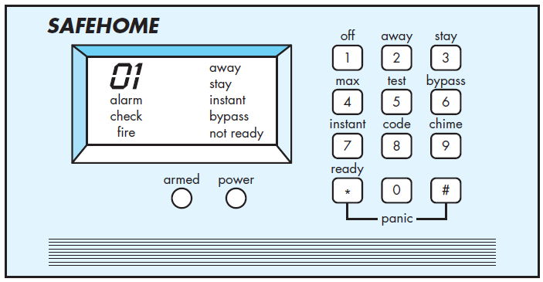
SafeHome

Slide 41
SafeHome – Basic Usecase Describes the interaction between the actor and the system
The homeowner observes the SafeHome control panel to determine if the system is ready for input. If the system is not ready, a not ready message is displayed on the LCD display, and the homeowner must physically close windows or doors so that the not ready message disappears. [A not ready message implies that a sensor is open; i.e., that a door or window is open
The homeowner uses the keypad to key in a four-digit password. The password is compared with the valid password stored in the system. If the password is incorrect, the control panel will beep once and reset itself for additional input. If the password is correct, the control panel awaits further action.
The homeowner selects and keys in stay or away to activate the system. Stay activates only perimeter sensors (inside motion detecting sensors are deactivated). Away activates all sensors.
When activation occurs, a red alarm light can be observed by the homeowner

Slide 42
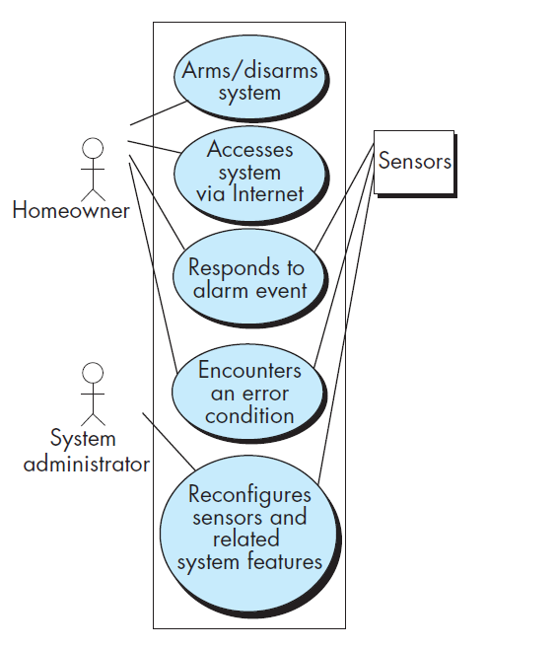
UML use case diagram for SafeHome home security function

Slide 43
Building the Analysis Model
8.5

Slide 44
Building the Analysis Model
The intent of the analysis model is to provide a description of the required informational, functional, and behavioral domains for a computer-based system
The model changes dynamically as you learn more about the system to be built, and other stakeholders understand more about what they really require
For that reason, the analysis model is a snapshot of requirements at any given time
You should expect it to change

Slide 45
Elements of the Analysis Model
There are many different ways to look at the requirements for a computer-based system
Different modes of representation force you to consider requirements from different viewpoints
A set of generic elements is common to most analysis models

Slide 46
Scenario-based elements
The system is described from the user’s point of view using a scenario-based approach
For example, basic use cases and their corresponding use case diagrams evolve into more elaborate template-based use cases
Scenario-based elements of the requirements model are often the first part of the model that is developed
As such, they serve as input for the creation of other modeling elements

Slide 47
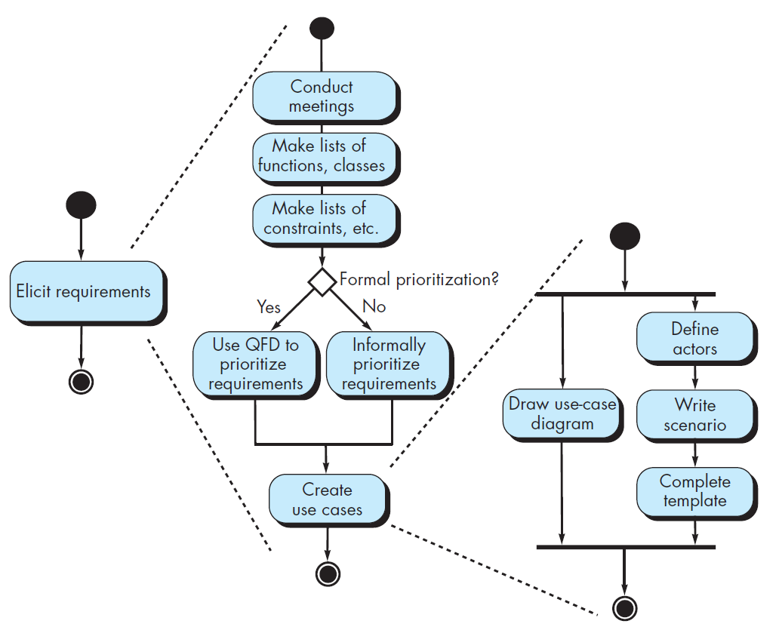
UML activity diagrams for eliciting requirements
Three levels of elaboration are shown, culminating in a scenario-based representation

Slide 48
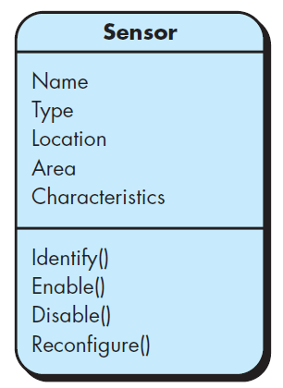
Class-based elements
Each usage scenario implies a set of objects that are manipulated
as an actor interacts with the system
These objects are categorized into classes—a collection of things that have similar attributes and common behaviors
For example, a UML class diagram can be used to depict a Sensor class for the SafeHome security function
Note that the diagram lists the attributes of sensors (e.g., name, type) and the operations (e.g., identify, enable ) that can be applied to modify these attributes

Slide 49
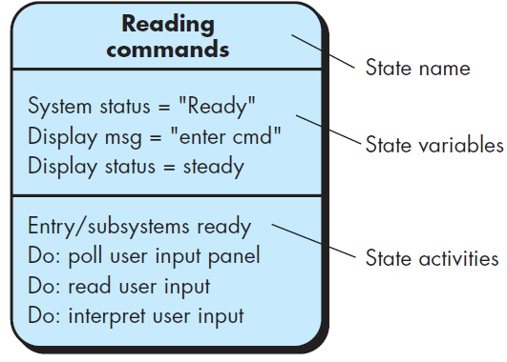
Behavioural Elements
The behavior of a computer-based system can have a profound effect on the design that is chosen and the implementation approach that is applied
The state diagram is one method for representing the behavior of a system by depicting its states and the events that cause the system to change state
A state is any observable mode of behavior
In addition, the state diagram indicates what actions (e.g., process activation) are taken as a consequence of a particular event

Slide 50
Agile Requirements Engineering
As the agile team acquires a high-level understanding of a product’s critical features use stories relevant to the next product increment are refined
The agile process encourages the early identification and implementation of the highest priority product features
This allows the early creation and testing of working prototypes

Slide 51
Agile Requirements Engineering
Agile requirements engineering addresses important issues that are common in software projects:
high requirements volatility,
incomplete knowledge of development technology, and
customers not able to articulate their visions until they see a working prototype
The agile process interleaves requirements engineering and design activities

